Slide 1
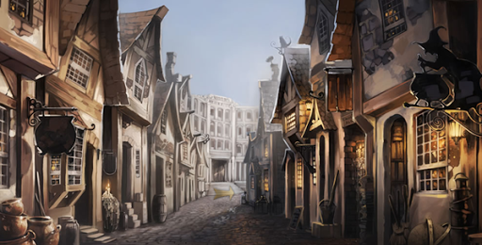
Diagon Alley – Read Chapter 5

Slide 2
Summarising to the point
Summarise the whole chapter in less than fifty words.

Slide 3
Noun Phrases
What is a noun phrase?
How can you write one? What type of words can be used?
How can you identify a noun phrase?
Y6: Spring Revision Block B

Slide 4
Nouns
A noun names a person, place, idea, thing or feeling.
Adjectives
An adjective is a describing word.
It tells you more about a noun.
noun phrases
a wand
the cauldron
an owl
scales
a new magic wand
the pewter cauldron
a powerful owl
brass scales
In front of a noun, we often have
a an the
A noun phrase adds extra detail to the noun.
determiners
Y6: Spring Revision Block B

Slide 5
These noun phrases include nouns, adjectives and determiners.
We can test a noun phrase by seeing if it can be replaced by a pronoun.
noun phrases
a new magic wand
the pewter cauldron
a powerful owl
brass scales
He put the new cauldron in his pocket.
He put it in his pocket.
A noun phrase adds extra detail to the noun.
Y6: Spring Revision Block B

Slide 6
Expanded Noun Phrases
You can develop an expanded noun phrase by adding a prepositional phrase.
the battered, pewter cauldron
the battered, pewter cauldron in the shop
noun phrases
the battered, pewter cauldron with silver handles
a new magic wand
the pewter cauldron
a powerful owl
brass scales
the battered, pewter cauldron at the back
The prepositional phrase modifies the noun…
and expands the image of the noun.
Prepositions
with, of, by, from, on, under, below, between, inside, next to, over, by, in
Y6: Spring Revision Block B

Slide 7
Remember
– noun phrases have head (main) noun
- noun phrases add detail about the head noun
- noun phrases can be replaced by a pronoun
Can you spot the noun phrases?
Students will need three sets of black, plain work robes.
You may wear a winter cloak with black or silver fastenings.
One pair of protective dragon hide gloves is recommended.
Parents are reminded that first year students are not permitted to bring broomsticks.
Magic wands from Ollivander’s must not be used outside school.
Use ideas from the chapter and create five of your own sentences that include an expanded noun phrase.
ANSWERS
Y6: Spring Revision Block B

Slide 8
Learning Objectives
By the end of the lesson you will…
Be able to select and retrieve information from the novel

Slide 9
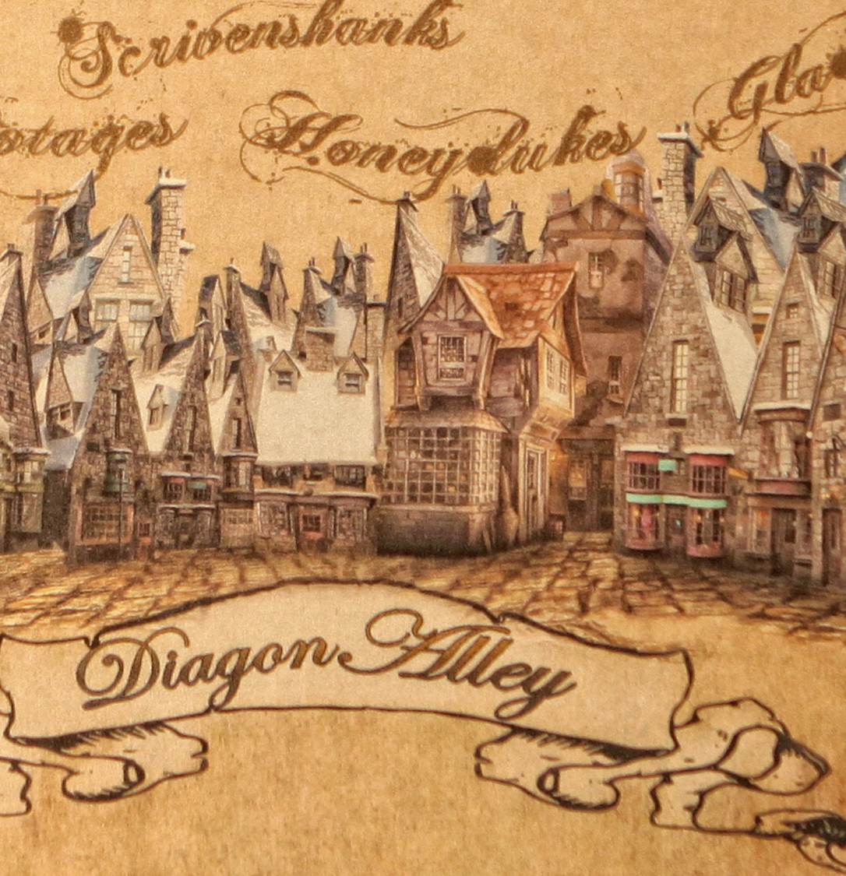
Creating a Map of Diagon Alley
Create a map of Diagon Alley in your exercise book
(turn it to portrait).
Include some of the shops mentioned in the chapter and create three of your own. Add labels, brief descriptions and colour.

Slide 10
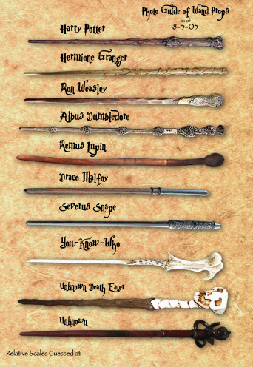
Creating your own Wand
Now it’s time to create your own wand.
Draw a picture of your wand and describe it carefully in a paragraph.
Things to think about:
What tree (wood) is your wand made from and what power or strength does this give it.
What creature’s qualities are captured within your wand? For example at the core of Harry’s wand is a phoenix feather.
If you can, find things in your garden and create your wand.

