Slide 1
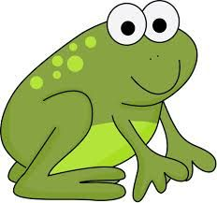
Use Frog (counting up) to subtract pairs of numbers.
Harry’s best javelin throw at sports day last summer was 9.67 metres, but today he has thrown a huge 11.32 metres! How much further has he thrown?
How could we calculate this?
We are adding 33cm, but our number line is in metres, so we write this as 0.33.
0.33m
9.67m
10m
11.32m

Slide 2
Use Frog (counting up) to subtract pairs of numbers.
Harry’s best javelin throw at sports day last summer was 9.67 metres, but today he has thrown a huge 11.32 metres! How much further has he thrown?
1.32m + 0.33m = 1.65m
1.32m + 0.33m = ?
Now add the hops.
1.32m
0.33m
9.56m
10m
11.32m

Slide 3
Use Frog (counting up) to subtract pairs of numbers.
Distance | Measurement
Classroom width | 4.56m
Classroom length | 5.3m
Hall length | 10.4m
Hall width | 7.56m
Table width | 0.5m
Table length | 1.25m
How much longer is the classroom than it is wide?
Draw an empty number line jotting to show how we could find this difference.
0.04 to 4.6, then 0.4 to 5, or one big jump of 0.44.
0.44
Then 0.3 to 5.3.
We need to be careful with numbers’ place value when adding tenths/ tenths and hundredths/ hundredths.
0.4m + 0.3m + 0.04m = 0.74m, or 74cm
Notes:
Some children may feel confident to jump from 4.56 to 5, rather than hopping to 4.6 first.

