Slide 1
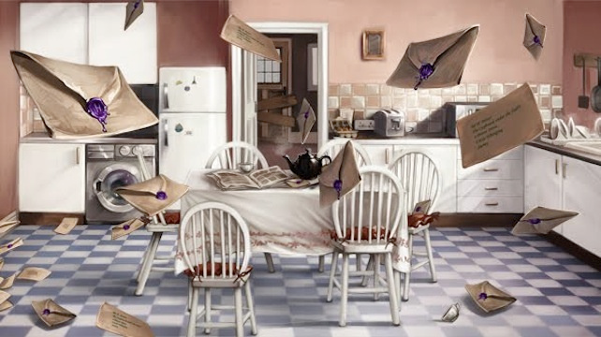
The Letters from No One

Slide 2
Vocabulary
Read chapter 3 then answer the questions:
What does it mean to wrinkle your nose? Page 35
Find evidence that shows that Harry is excited about the letter. Page 36
What is ‘bawling’? Page 40
Find and copy a phrase on Page 41 that shows that Dudley is upset.
(Hint) – Remember a phrase is two or three words without a verb.

Slide 3
Adverbs
An adverb tells you more about a verb.
sharply
casually
stiffly
horribly
fast
“No,” she said sharply.
He spoke as casually as he could.
His heart sank fast.
Which verb is being modified by the adverbs?
Y6: Spring Revision Block A

Slide 4
Adverbs
An adverb tells you more about a verb.
sharply
casually
stiffly
horribly
fast
“No,” she said sharply.
He spoke as casually as he could.
His heart sank fast.
An adverb can also add to an adjective.
Which verb is being modified by the adverbs?
He had a perfectly normal morning.
It was an obviously silly stunt.
adverb
adjective
noun
adverb
adjective
noun
Can you identify the noun, adjective and adverb?
Y6: Spring Revision Block A

Slide 5
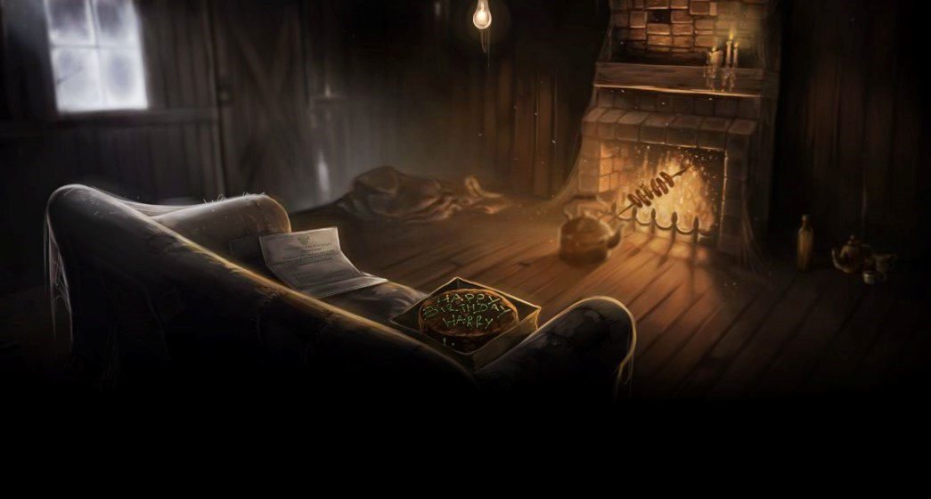
The Keeper of the Keys
Read Chapter 4

Slide 6
Infer – The Keeper of the Keys
Answer any 3 of the following questions using PEE – What is your point? What is your evidence? How do you know? Explain.
Do you think Harry enjoys the summer holidays? Why?
Why was Mrs Figgs no longer as fond of her cats?
Vernon’s face goes from red to green. What does this tell you?
What do you think Vernon means by ‘I’m not having one in the house’?
Why does Vernon hammer shut the door?
Why does Vernon make them leave?

Slide 7
How does the writer create a strong atmosphere here?
BOOM. They knocked again. Dudley jerked awake.
‘Where’s the cannon?’ he said stupidly.
There was a crash behind them and Uncle Vernon came skidding into the room. He was holding a rifle in his hands – now they knew what had been in that long, thin package he had brought with them.
‘Who’s there?’ he shouted. ‘I warn you – I’m armed!’
There was a pause. Then –
SMASH!
The door hit with such force that it swung clear off its hinges and with a deafening crash landed flat on the floor.
A giant of a man was standing in the doorway. His face was completely hidden by a long, shaggy mane of hair and a wild, tangled beard, but you could make out his eyes, glinting like black beetles under all the hair. The giant squeezed his way into the hut, stooping so that his head just brushed the ceiling. He bent down, picked up the door and fitted it back easily back into the frame. The noise of the storm outside dropped a little. He turned to look at them all.

Slide 8
Atmosphere
Write down all the language you can find in the extract that creates atmosphere for the reader.
Draw the character of the giant of a man from the description making sure you use the author’s words to label your drawing.

