Slide 1
Monday
ure

Slide 2
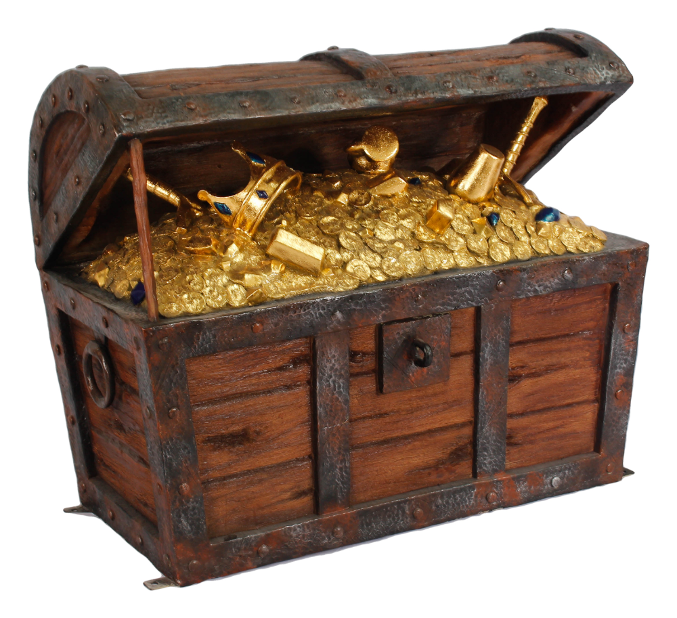
treasure

Slide 3
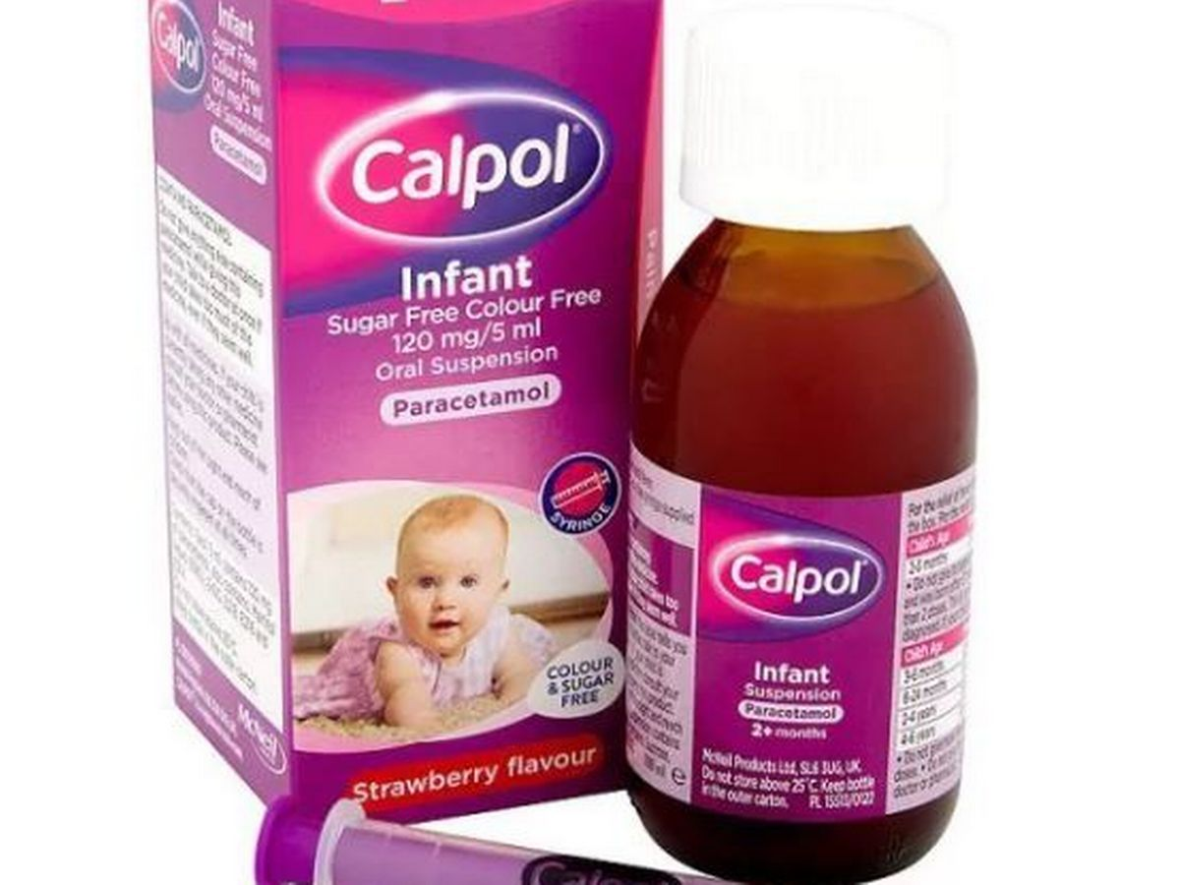
cure

Slide 4
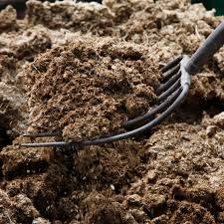
manure

Slide 5
sure

Slide 6
Tuesday
air

Slide 7
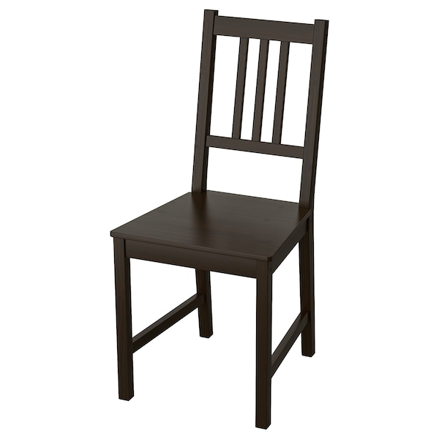
chair

Slide 8
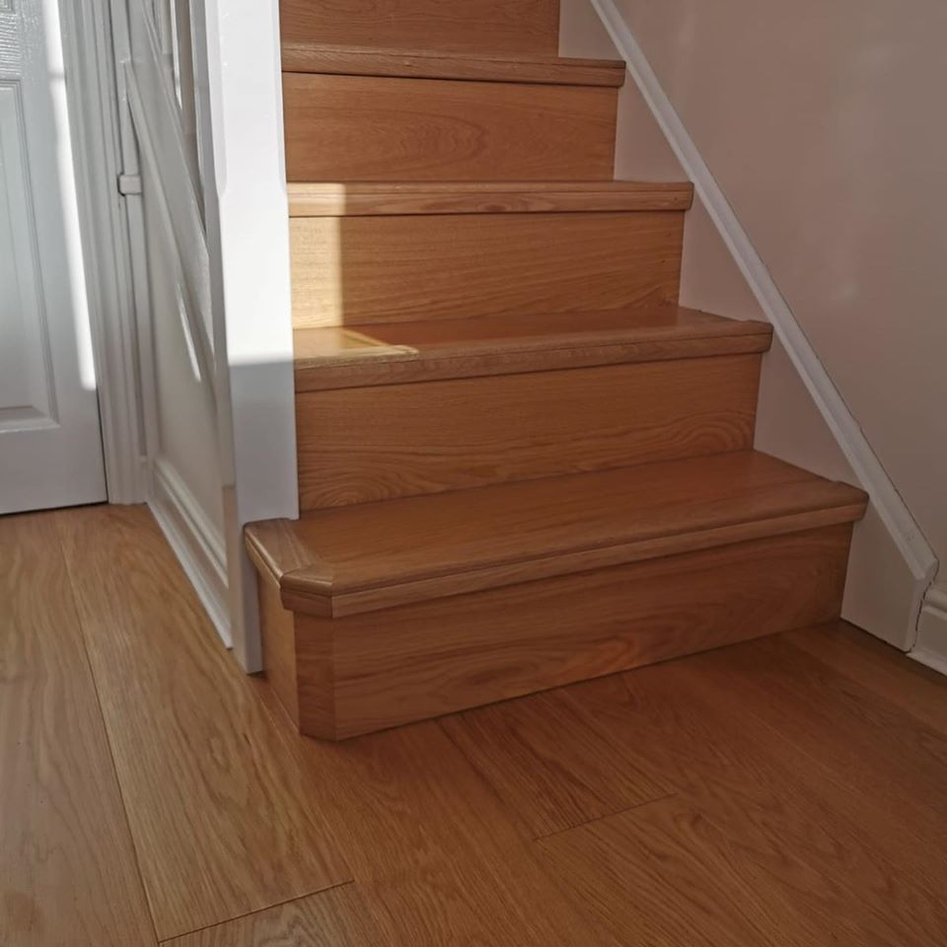
stair

Slide 9
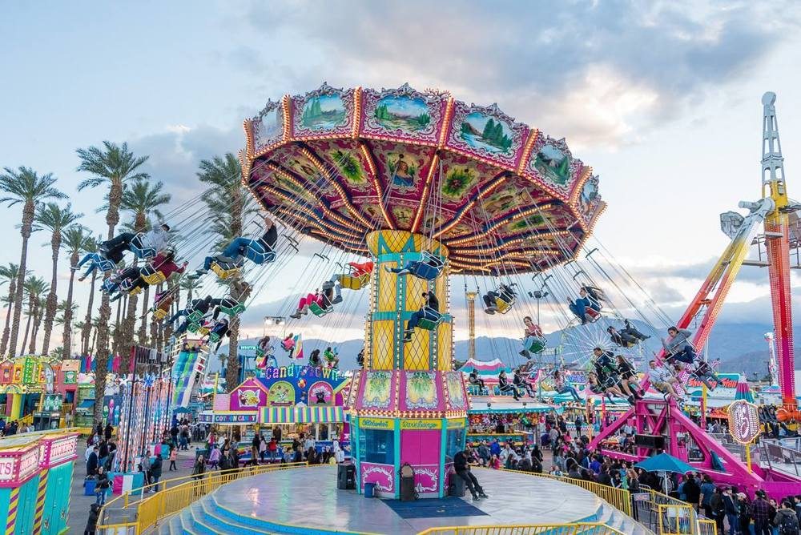
fair

Slide 10
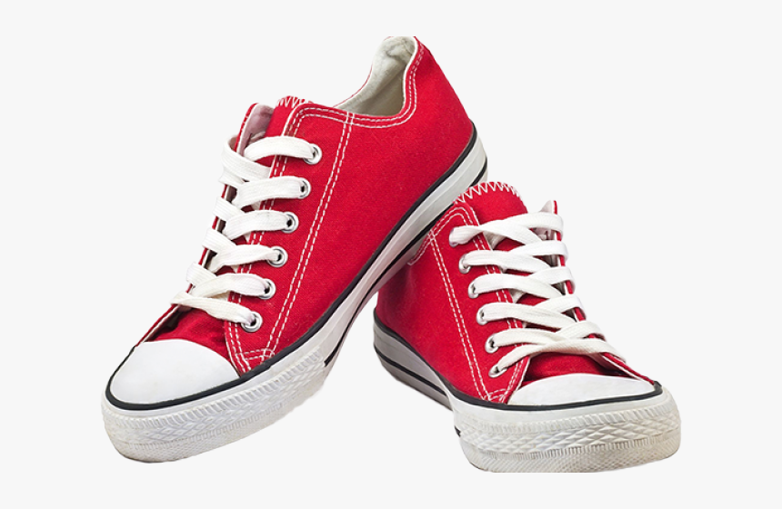
pair

Slide 11
Wednesday
er

Slide 12
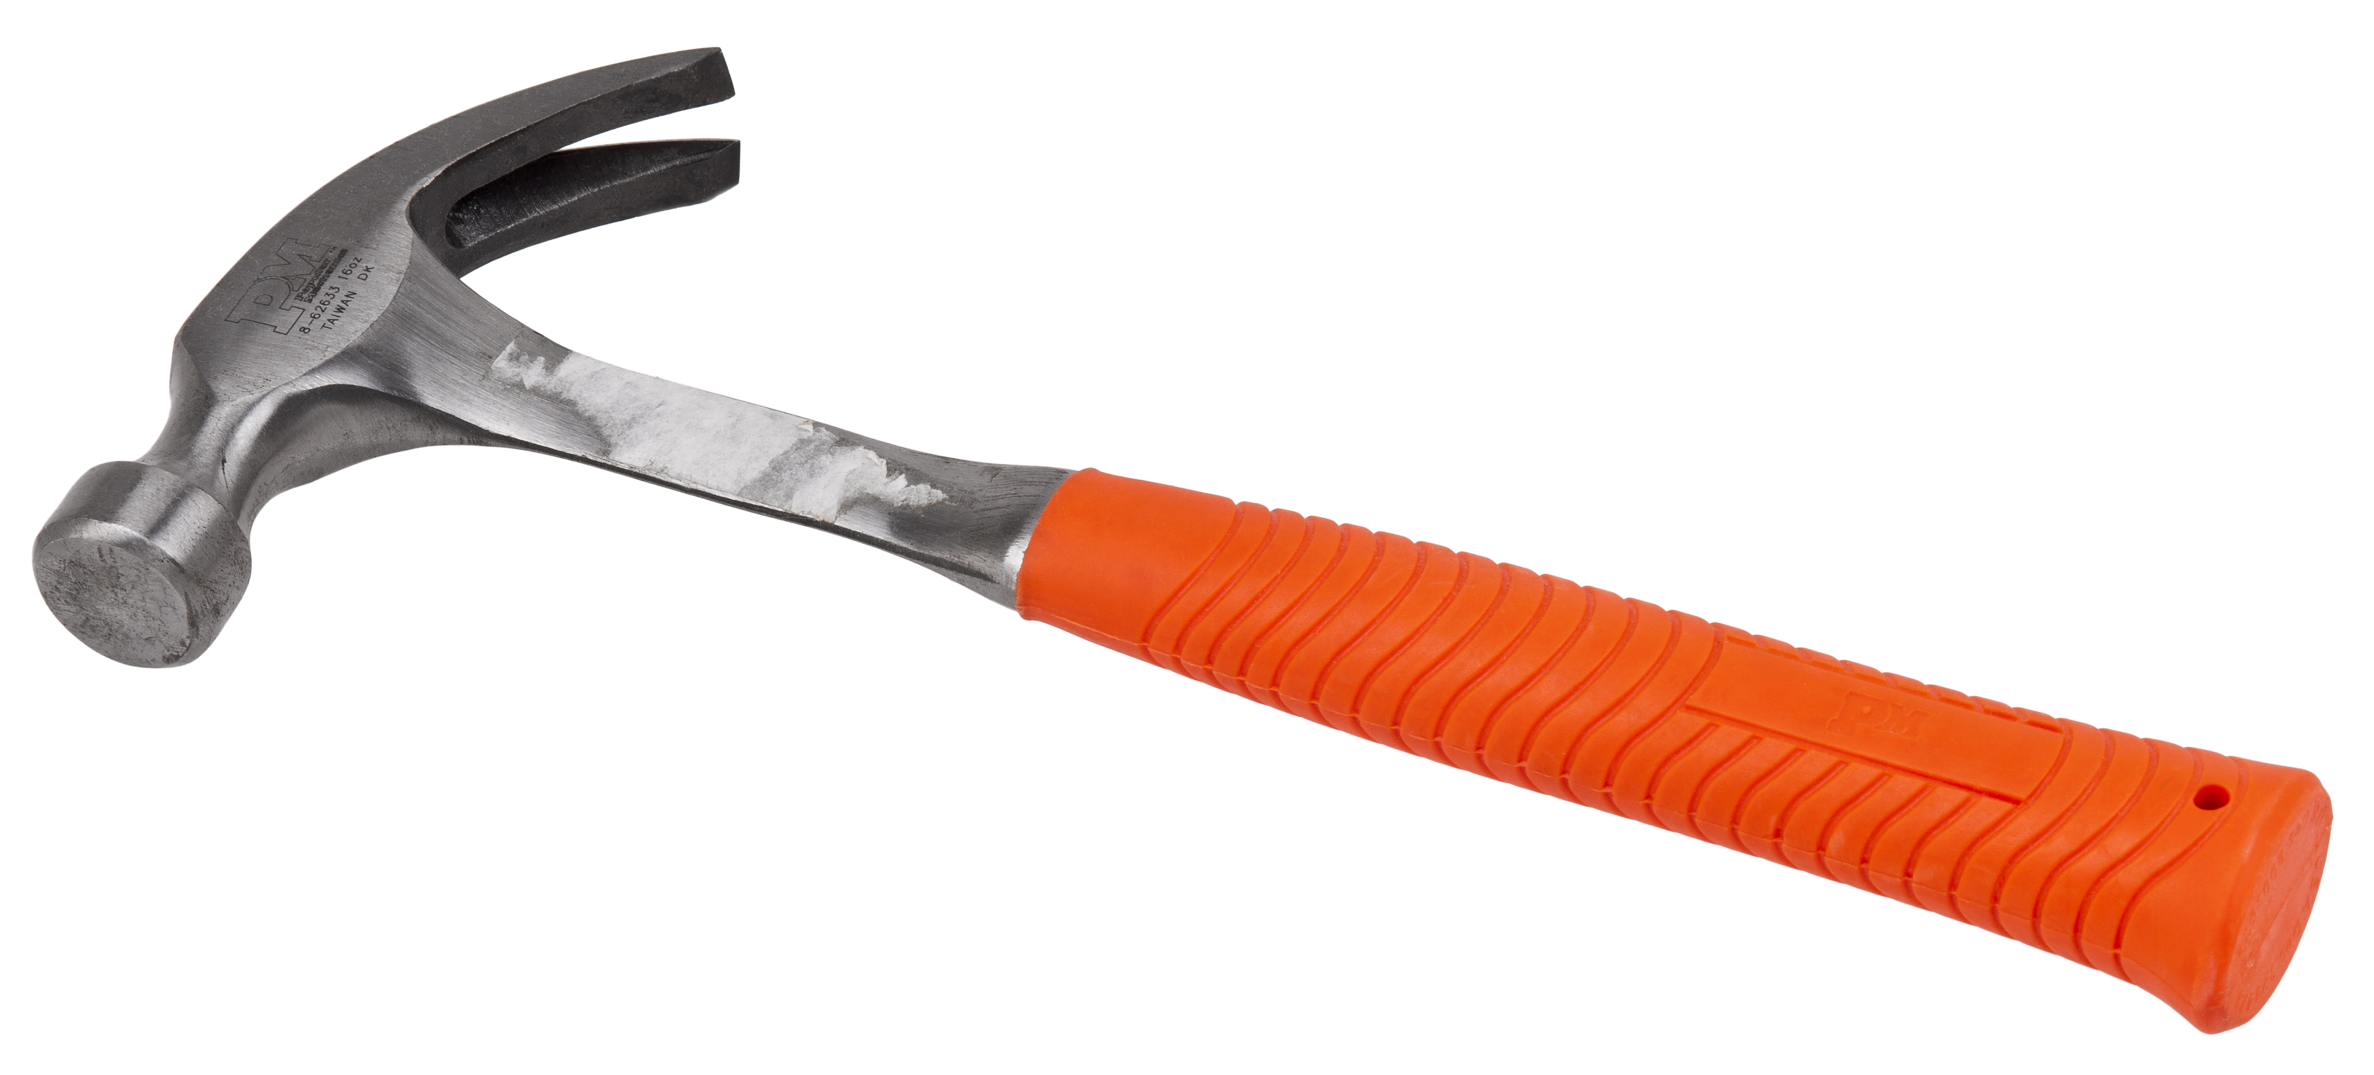
hammer

Slide 13
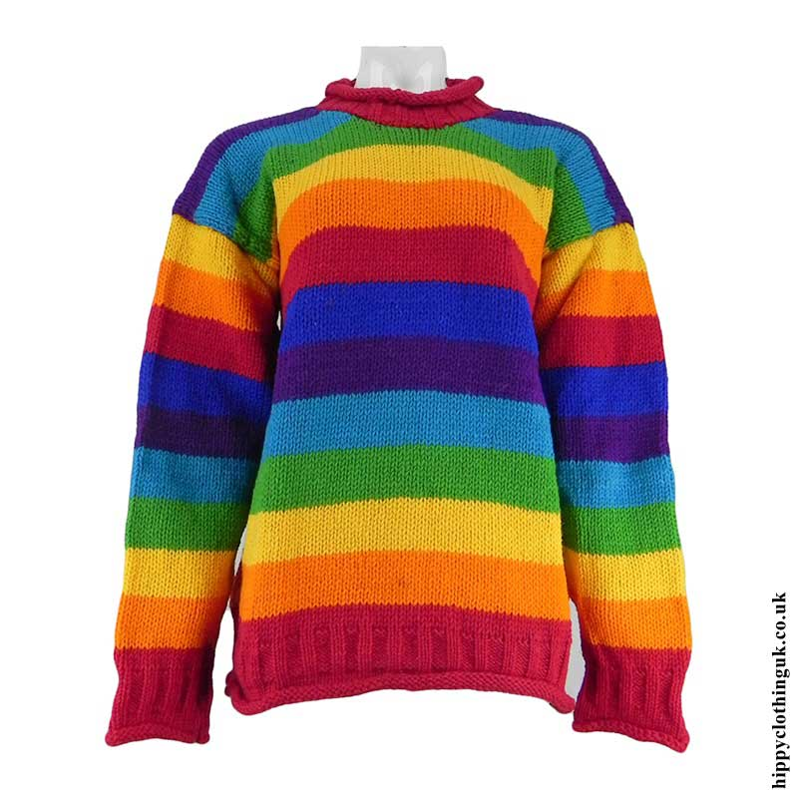
jumper

Slide 14
fern

Slide 15
flower

Slide 16
Thursday
Go on phonics play and revise all of your taught sounds from phase 2 and 3.
or
Write out some phonemes on bits of paper and play SPLAT!

Slide 17
Friday – Tricky word
be

