Slide 1
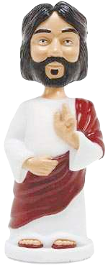
What would Jesus do? Can people live by the values of Jesus in the twenty-first century?
W.W.J.D?
To identify which commandment Jesus thought was the most important.
To reflect on why Christians ask the question ‘What Would Jesus Do?’
Children should investigate through discussion,
their responses do not have to be religious. I
have included some of my thoughts to help your discussions

Slide 2
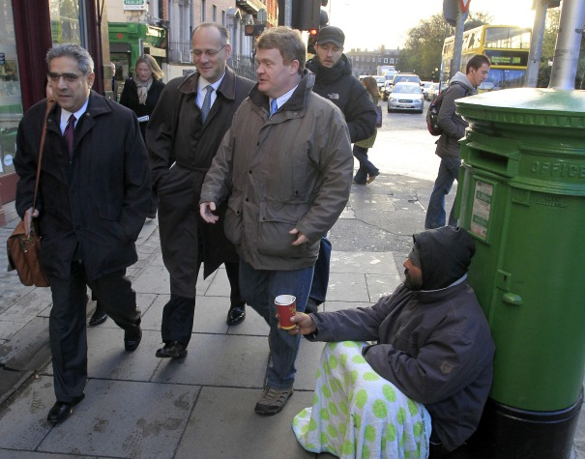
The Parable of the Good Samaritan
Starter:
You are out shopping with your friends and you walk past this man who asks you to spare some change.
What do you do?
Discuss:
My thoughts – I would not give money directly – but maybe give to a charity who supports these people instead.
Your responses to the following activity do not have to be religious.

Slide 3
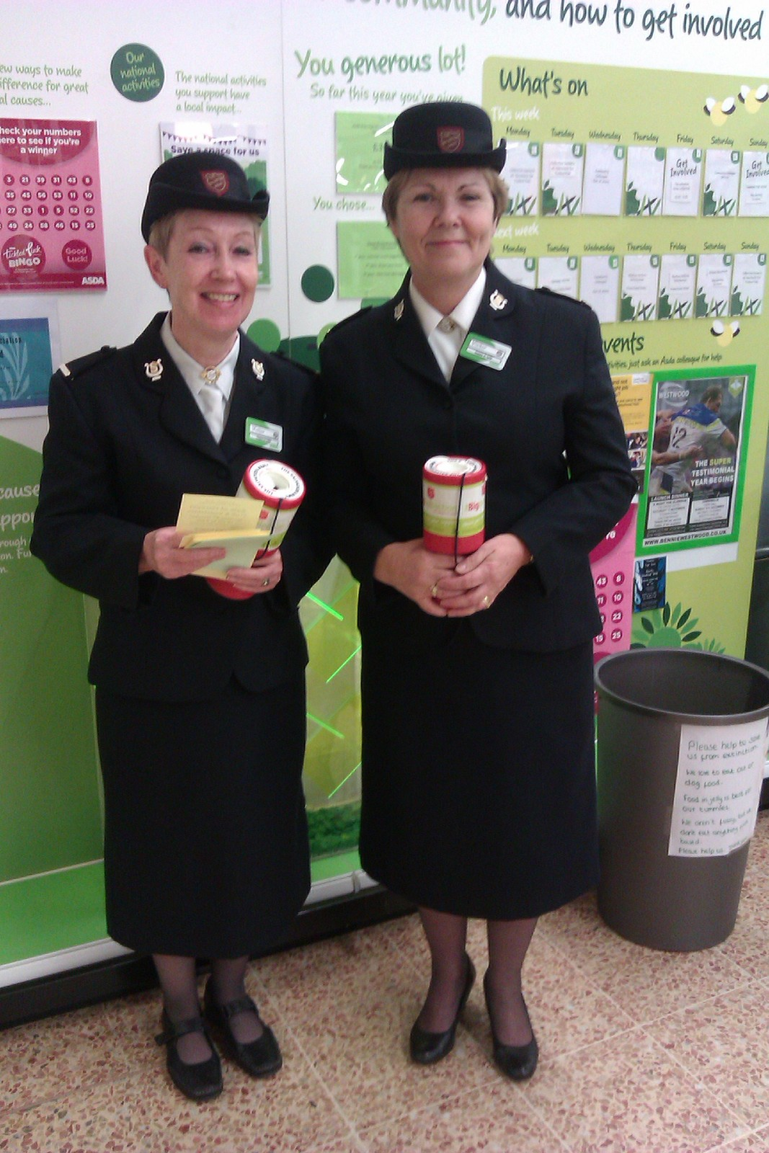
Would you feel more or less comfortable giving money to these ladies?
Why? Discuss
I would feel more comfortable giving to a charity than to a beggar.
I think this is because I feel the money would be used more effectively to help those in need.
Beggars can spend money on drugs and alcohol which is not going to improve their situation so I would rather money was given to charity to help them find a home and work.

Slide 4
You have £1 spare change in your pocket- would you give it to a homeless man, a charity representative, or your best friend who didn’t have enough money for the bus home?

Slide 5
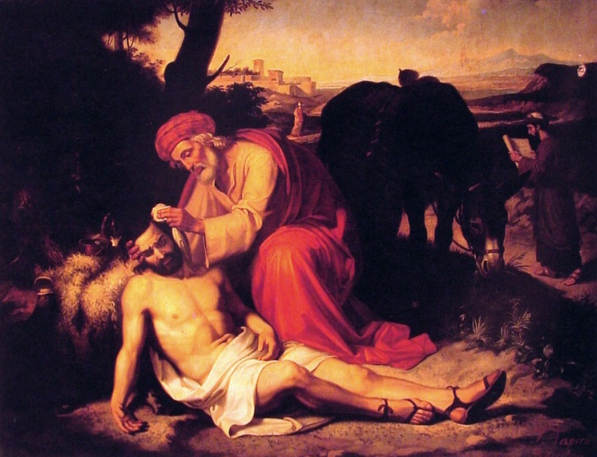
Lesson Objective: To understand the meaning behind the parable of the Good Samaritan for Christians.
Key Words:
Priest
Levite
Samaritan
Outcast

Slide 6
Read Through together
The Jews considered the Samaritans outcasts. They treated them as enemies and would have nothing to do with them.

Slide 7
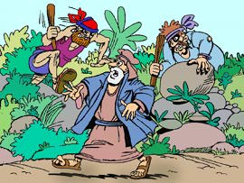
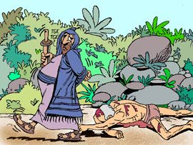
Luke 10:25-37 (New International Version)
So he asked Jesus, “And who is my neighbour?”
In reply Jesus said: “A man was going down from Jerusalem to Jericho, when he was attacked by robbers. They stripped him of his clothes, beat him and went away, leaving him half dead.
A priest happened to be going down the same road, and when he saw the man, he passed by on the other side.
So too, a Levite, when he came to the place and saw him, passed by on the other side.

Slide 8
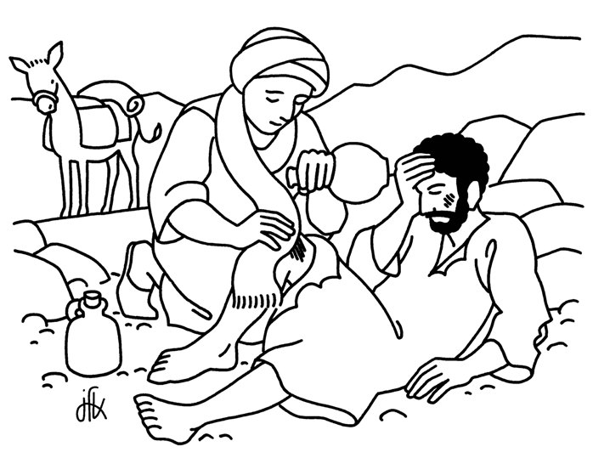
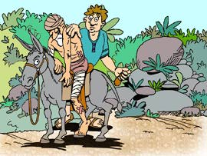
But a Samaritan, as he travelled, came where the man was; and when he saw him, he took pity on him.
He went to him and bandaged his wounds, pouring on oil and wine. Then he put the man on his own donkey, brought him to an inn and took care of him.
The next day he took out two denarii and gave them to the innkeeper. ‘Look after him,’ he said, ‘and when I return, I will reimburse you for any extra expense you may have.’

Slide 9
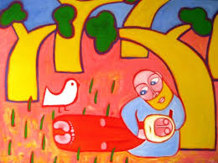
“Which of these three do you think was a neighbour to the man who fell into the hands of robbers?”
The expert in the law replied, “The one who had mercy on him.”
Jesus told him, “Go and do likewise.”

Slide 10
-Point “I Think….” -Evidence “For example….” -Explain This is because…
Love thy neighbour as you love yourself = treat others as you want to be treated
Give an example how Christians might follow the story of the Good Samaritan today?
Christians might follow the story of the good Samaritan today by ….
Do you think Christians find it easy to always treat people equally? Why?
I think it is/is not easy for Christians to always treat people equally because…
Useful conjunctions:
for example
such as
furthermore
also
in addition
Use the story, the powerpoint and real life situations today, to help you answer these questions. There are some lovely examples of people being heroic or raising money for good causes at the present time.

