Slide 1
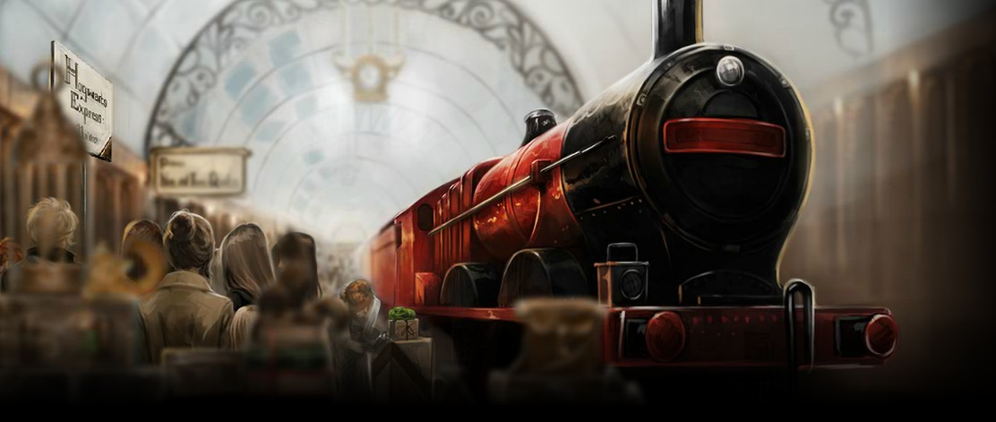
The Journey from Platform
Nine and Three Quarters

Slide 2
Adverbials
What are adverbials?
What do we mean when we say an adverbial is fronted?
How do we punctuate adverbials?
Y6: Spring Revision Block D

Slide 3
Adverbials
Adverbials tell us more about a verb.
The frog croaked
Adverbials can be
a word,
a phrase,
or a clause.
hungrily
on the lily pad
A phrase - two or three words no verb
A clause – has a verb
as spring arrived – arrived is a verb so this one is a clause
Y6: Spring Revision Block D

Slide 4
Adverbials answer the questions…
Harry rode his broom
Harry rode his broom into the clouds.
Harry rode his broom during the match.
Harry rode his broom with ease.
Where?
When?
How?
Y6: Spring Revision Block D

Slide 5
Adverbials
Adverbials often have a preposition at their head.
The bludger struck with deadly precision.
The bludger struck between his eyes.
The bludger struck at midnight.
Remember prepositions are position or place words e.g. on in beneath with under at
The preposition links the adverbial to the rest of the sentence.
Y6: Spring Revision Block D

Slide 6
Adverbials
Finish the adverbials in these sentences. Are you answering where, when or how?
Wood shouted above ...
Flint shoved Harry against …
Johnson soared with …
Higgs laughed at…
Pucey blocked the goal as…
Y6: Spring Revision Block D

Slide 7
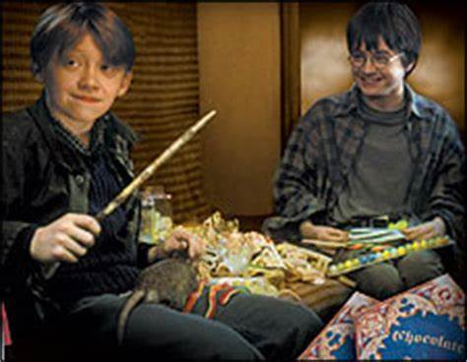
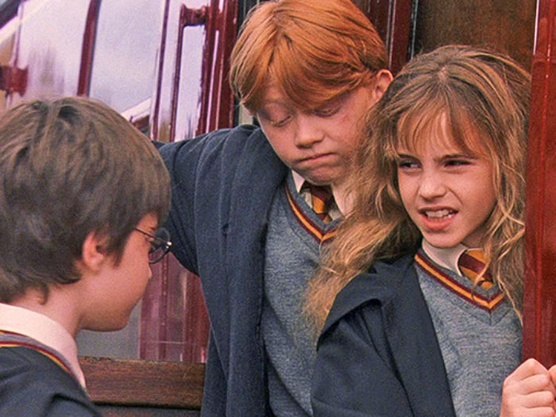
The Journey from Platform Nine and Three Quarters
Vocabulary –
What does ‘barking’ mean on pg 96?
Find evidence on Page 97 that shows Harry is nervous.
Find evidence that conveys Draco’s displeasure on pg 116.
Define ‘bewitched’. Pg 117
Explain - What are your first impressions of Hermione? Why?
Summarise your first impressions of Ron and Hermione by picking a word to describe each and explaining your choice.

Slide 8
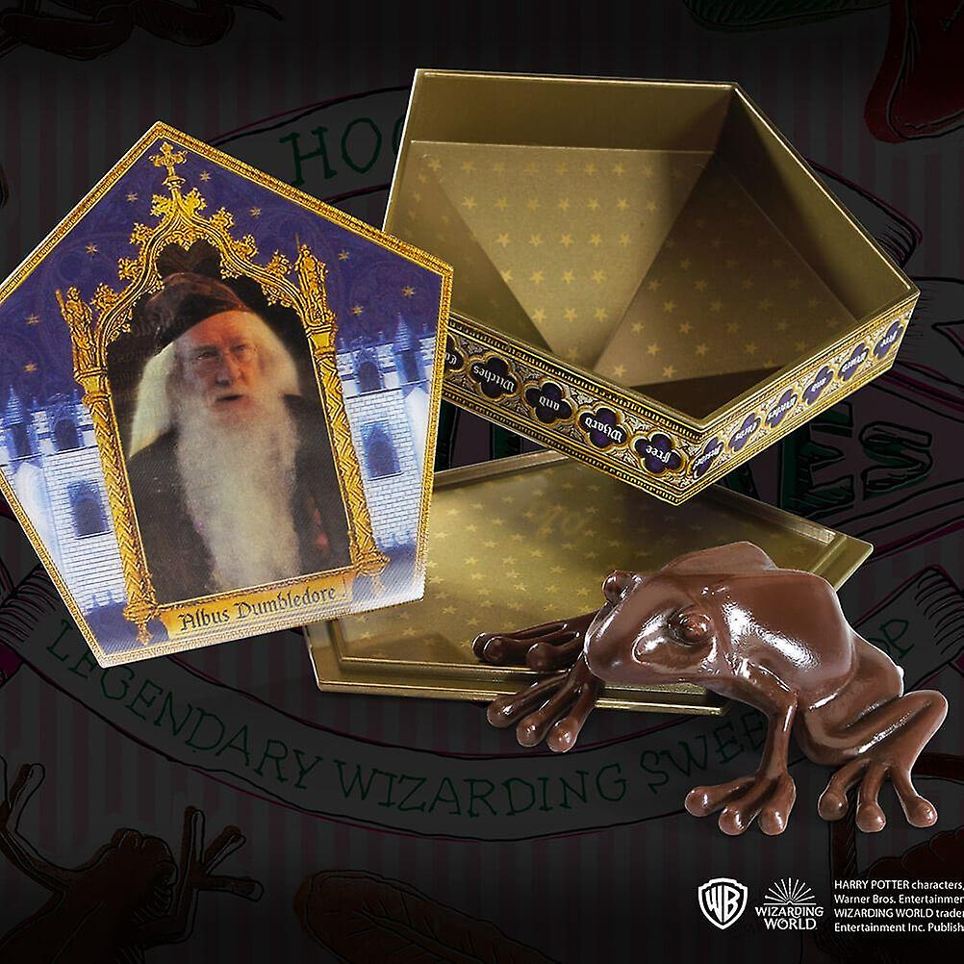
At Hogwarts the children by chocolate frogs so that they can collect cards of famous witches and wizards – Choose your favourite character and create a collectors’ card to represent them. Try to include an adverbial and link it to the rest of your sentence in your description of the wizard you choose.
Chocolate Frogs
Harry opened a chocolate frog on the train (pg 109). It gives a description of Dumbledore and his greatest achievements.
If you don’t know your wizard’s greatest achievements make them up. You can use the wizard that you created if you would prefer.
Extend:
Choose 4 wizards and make a set of Top Trumps – What qualities and skills will you choose?

