Slide 1
Newspaper Reports

Slide 2
What is a newspaper report?
Newspapers report on news stories from around the world every day. They are written in the past tense because they are reporting on things that have already happened.
Have you ever read a newspaper?

Slide 3
Headlines
Newspapers use headlines to grab your attention. Headlines try to tell the story in as few words as possible and are usually bigger than the other text.
Can you guess what these stories are going to be about by reading the headlines?
‘Elephant escapes and charges through village!'
'Watery weather washes out Wadhurst!'
Some headlines are funny and others are more serious, depending on the type of story they are about to tell.

Slide 4
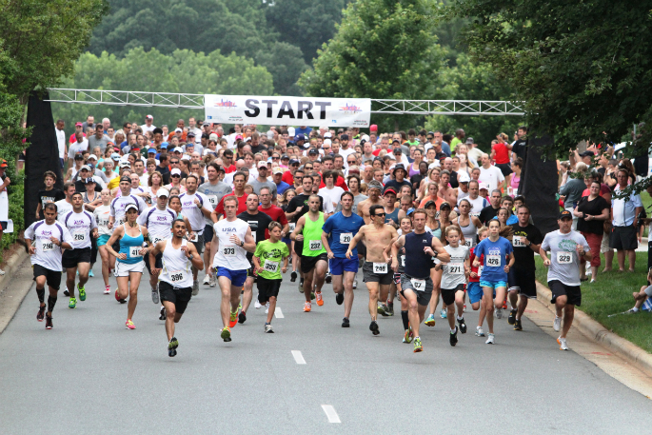
What would be a good headline for this picture?

Slide 5
Facts
Newspaper reports use facts to tell their stories. They often use the 5 W's, (who, what, why, when and where) to give their readers as many facts as possible.
Often a reporter has to do a lot of research to find out all the facts.

Slide 6
Opinions
When the facts have been given, the person writing the newspaper report sometimes gives their opinion of the story, why it happened or what they think about the people in the story.
Opinions are not facts, they are what someone thinks about something.

Slide 8
Photos and captions
Photos and captions help to tell the story by giving readers a picture of what happened, where it happened or who it happened to.
Photos need to tell the story as much as the words do.
Photos also need a caption underneath them. A caption is a short sentence explaining what is happening in the photograph.

Slide 9
Can you think of a caption for this picture?

Slide 10
Writing a newspaper report
Choose a subject
Research your facts
Think of a headline
Write your report
Find a picture
Write a caption

