Slide 1
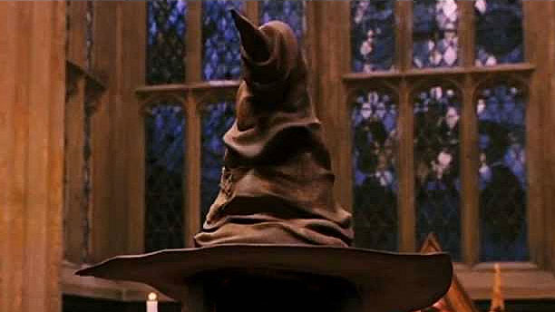
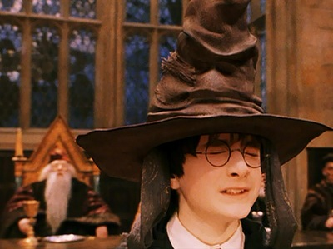
The Sorting Hat

Slide 2
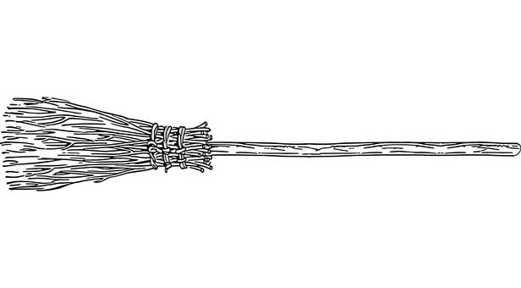
Fronted Adverbials
Adverbials can be placed at the beginning or end of a clause.
When an adverbial appears in front of the sentence it is modifying…
it is called a fronted adverbial.
No special punctuation needed
Comma after the fronted adverbial
Snape chanted during the game.
Flint blocked Harry with a mean sneer.
Ron lost his temper before long.
Hermione took action finally.
During the game, Snape chanted.
With a mean sneer, Flint blocked Harry.
Before long, Ron lost his temper.
Finally, Hermione took action.
Fronted adverbials are separated from the main part of the sentence by a comma.

Slide 3
ANSWERS
Spotting & Punctuating Adverbials
Spot the adverbial in each sentence.
Decide if punctuation is needed and where.
Without warning Slytherin takes the quaffle.
Johnson wins possession with a bold tackle.
Like a bullet Potter swoops towards the snitch.
Recklessly Flint strikes Wood.
The crowd roars below in the stands.
Task: Write out each sentence and decide where the commas should go.

Slide 4
ANSWERS
Spotting & Punctuating Adverbials
Spot the adverbial in each sentence.
Decide if punctuation is needed and where.
Without warning Slytherin takes the quaffle.
Johnson wins possession with a bold tackle.
Like a bullet Potter swoops towards the snitch.
Recklessly Flint strikes Wood.
The crowd roar below in the stands.
,
,
,

Slide 5
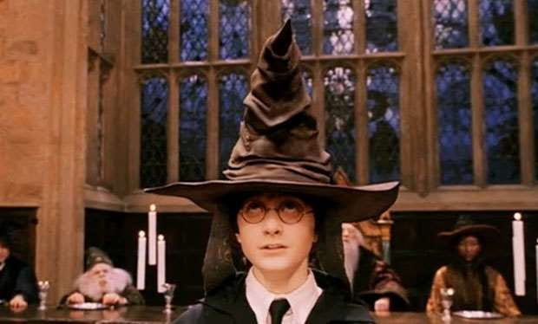
The Sorting Hat
Vocabulary:
What does mutely mean?
What adjectives describe the hat on pg 125?
What does this make it seem like?
What is chivalry?
What does a ‘resident ghost’ mean pg 132?
Summarise this chapter in less than forty words.

Slide 6
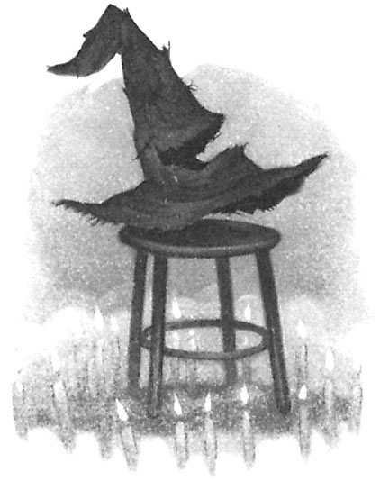
The Sorting Hat Song
Oh you may not think I’m pretty, But don’t judge on what you see, I’ll eat myself if you can find, A smarter hat than me. You can keep your bowlers black, Your top hats sleek and tall, For I’m the Hogwarts Sorting Hat And I can cap them all. There’s nothing hidden in your head The Sorting Hat can’t see, So try me on and I will tell you Where you ought to be. You might belong in Gryffindor, Where dwell the brave at heart, Their daring, nerve and chivalry Set Gryffindor’s apart; You might belong in Hufflepuff, Where they are just and loyal, Those patient Hufflepuffs are true And unafraid of toil; Or yet in wise old Ravenclaw, If you’ve a ready mind, Where those of wit and learning, Will always find their kind; Or perhaps in Slytherin You’ll make your real friends, Those cunning folk use any means To achieve their ends. So put me on! Don’t be afraid! And don’t get in a flap! You’re in safe hands (though I have none) For I’m a Thinking Cap!

Slide 7
Slytherin | Gryffindor
Hufflepuff | Ravenclaw
The Hogwart’s Sorting Hat
The Sorting Hat Song, on the previous slide, mentions the characteristics of each Hogwart’s house.
Read the descriptions of each house carefully and explain what the words mean with definitions.
Then decide which house you would be in and tell me why you belong in that house.
Extend:
Create your own Hogwart’s house. Include:
A name
A crest (with house colours)
A slogan
A paragraph describing the personality of the House
Create another section for The Sorting Hat Song that describes the characteristics of your house.

