Slide 1
Hallowe’en

Slide 2
Learning Objectives
By the end of the lesson you will…
Be able to explore the format of a non-fiction text
Be able to reproduce the format, tone and structure of a non-fiction text
To identify word classes

Slide 3
Word Classes 1) Noun 2) Verb 3) Adjective 4) Adverb 5) Preposition 6) Determiner 7) Pronoun 8) Conjunction
What terms do you remember?
Can you tell a partner what they mean?
Can you give examples of any?
Use the following slides to revise word classes and try to give examples of your own for each word class.

Slide 4
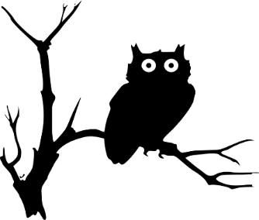
Nouns
A noun names a person, place, idea, thing or feeling.
a boy
the cupboard
an owl
a mystery
In front of a noun, we often have
a an the
determiners

Slide 5
Nouns
A noun names a person, place, idea, thing or feeling.
Proper nouns are shown using capital letters.
Harry
Privet Drive
Hedwig an owl
My favourite treat is a Chocolate Frog.
When a noun is a particular name it is called a
proper noun.

Slide 6
Verbs
Verbs indicate that someone or something is
doing, feeling or being.
Dursley blinked.
The cat waited.
They have a secret.
I wish!
Usually verbs have the name of a person or thing or a pronoun in front of them.

Slide 7
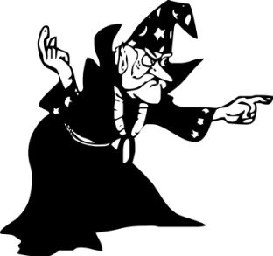
Adjectives
An adjective is a describing word.
It tells you more about a noun.
those funny clothes
some mysterious news
a nice, normal day
her pursed lips
The clothes were funny.
Adjectives sometimes come next to ‘their’ nouns…
but sometimes they do not.

Slide 8
Adverbs
An adverb tells you more about a verb.
sharply
casually
stiffly
horribly
fast
“No,” she said sharply.
He spoke as casually as he could.
His heart sank fast.
Which verb is being modified by the adverbs?

Slide 9
Adverbs
An adverb tells you more about a verb.
sharply
casually
stiffly
horribly
fast
“No,” she said sharply.
He spoke as casually as he could.
His heart sank fast.
An adverb can also add to an adjective.
Which verb is being modified by the adverbs?
He had a perfectly normal morning.
It was an obviously silly stunt.
adverb
adjective
noun
adverb
adjective
noun
Can you identify the noun, adjective and adverb?

Slide 10
Prepositions
Prepositions link a noun or noun phrase to a sentence.
There was a cat reading a map
on the corner.
Owls swooped
in broad daylight.
He yelled
at five different people.
He found it hard to concentrate
after lunch.
Prepositions tell us how words are related.
They can tell us about time, place and cause.

Slide 11
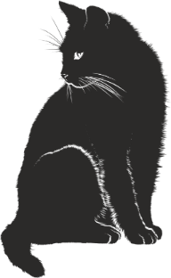
Determiners
Determiners stand in front of nouns.
They specify a noun.
A cat stood on the corner.
any cat
The cat stood on the corner.
That cat stood on the corner.
a particular cat
My cat stood on the corner.
a cat which belongs to…
Your cat stood on the corner.
Every cat stood on the corner.
Some cats stood on the corner.
a specified number of cats

Slide 12
Pronouns
Pronouns can stand in the place of a noun or noun phrase.
What pronouns could replace these nouns and noun phrases?

Slide 13
Pronouns
Pronouns can stand in the place of a noun or noun phrase.
He
them
What pronouns could replace these nouns and noun phrases?
Mr Dursley came into the room carrying two cups of tea.
He
her
Mr Dursley would have to say something to Mrs Dursley.
It
They
it
The news could not be ignored. Mr and Mrs Dursley needed to talk about the news.

Slide 14
Conjunctions
Co-ordinating conjunctions
and
but
or
Co-ordinating conjunctions join two words or clauses.
What conjunctions could be inserted
The cat sat and waited.
The cat might have been reading a map or he may have imagined it.
Subordinating conjunctions
when
while
before
because
so
if
unless
although
Mr Dursley was snoring but the cat was showing no sign of sleepiness.
Subordinating conjunctions introduce subordinate clauses.
It was nearly midnight before the cat moved.
What conjunctions could be inserted
A man appeared while the cat waited.
Because he sensed he was being watched, Dumbledore looked up.

Slide 15
Word Classes – Check your knowledge 1) Noun 2) Verb 3) Adjective 4) Adverb 5) Preposition 6) Determiner 7) Pronoun 8) Conjunction
verb
motorbike
preposition
landed
noun
on
determiner
Identify the Word Class
a
adverb
steadily
although
conjunction
adjective
huge
they
pronoun
Click to check.

Slide 16
The Troll
Remember: an adjective makes sense when you put ‘seems’ in front of it – seems happy, seems sad.
The troll is a fearsome creature up to twelve feet tall and weighing over a tonne. Notable for its equally prodigious strength and stupidity, the troll is often violent and unpredictable. Trolls originated in Scandinavia but these days they may be found in Britain, Ireland and other areas of northern Europe.
Trolls generally converse in grunts that appear to constitute a crude language, though some have been known to understand and to even speak a few human words. The more intelligent of the species have been trained as guardians.
There are three types of troll: mountain, forest and river. The mountain troll is the largest and most vicious. It is bald, with a pale-grey skin. The forest troll has a pale-green skin and some specimens have hair, which is green or brown, thin and straggly. The river troll has short horns and may be hairy. It has purplish skin and is often found lurking beneath bridges. Trolls eat raw flesh and are not fussy in their prey, which ranges from wild animals to humans.
What do you notice about the tone of the description? Where could this extract have come from?
Why does the writer change paragraphs? Decide on three subheadings for the paragraphs.
Pick out some of the adjectives in the extract that show the troll’s appearance and personality.

Slide 17
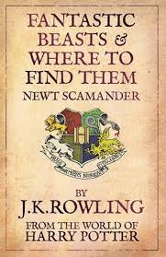
Create your own Fantastic Beast
Create your own magical creature to add to ‘Fantastic Beasts & Where To Find Them’.
Write three paragraphs, focusing on the areas discussed in the troll extract.
Include a sketch when you have finished.
Some ideas:
Unicorn | Pixie | Dragon
Phoenix | Centaur | Chimaera
Sea Serpent | Yeti | Fairy

