Slide 1
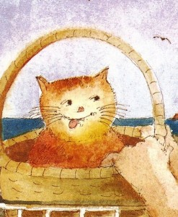
Seagull
Hamish
Mr Grinling
Mrs Grinling

