Slide 1
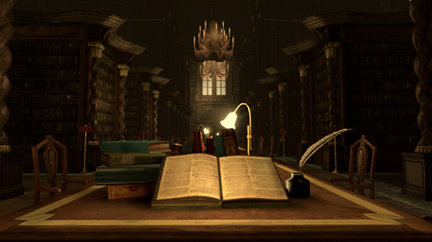
The Mirror of Erised

Slide 2
Learning Objectives
By the end of the lesson you will…
Understand how a writer creates suspense and tension.
Be able to create a narrative that builds suspense and tension.
To understand, use and apply the colon.

Slide 3
Colon
The colon : can be used in a number of ways,
including
before a list of words or phrases
2. in the 24 hour clock
3. to signal to the reader that something important is coming.

Slide 4
Colon continued
Add colons where appropriate and explain why they are there. Then make up 5 sentences of your own - use the story for ideas.
Here are some of the places we visited Edinburgh, Glasgow and Inverness.
In the 24 hour clock 1pm is 1300 hours.
I have only one thing to ask what do we do now?
These teams reached the semi-finals Chelsea, West Ham, Fulham and Liverpool.
The train leaves at 1500 hours, so please don’t be late.
He dropped on one knee and popped the question will you marry me?
These are the colours of the flag of France blue, white and red.
An 11-year-old boy sneaked on board the 1415 flight for Rome.
To be or not to be that is the question.
In front of him were the following mince pies, trifle, crackers and party poppers.

Slide 5
Building Suspense and Tension in Writing
Suspense & Tension
Imagery
foreboding
Varied sentence lengths
Slow pace
The attic door creaked open. Something rustled in the darkness. I stared, but could see nothing beyond the vague shapes of old suitcases and trunks piled high. It smelt damp. I struggled up into the attic and wedged the door open. Light poured into darkness. The darkness in the head of the house. I balanced carefully upon the floor beams. I knew that if I stepped onto plaster I could fall straight through into the room below. A cobweb brushed my face and I felt the sudden tickle of a spider crawl across my cheek. As I made my way forwards, it grew darker and colder. I was blocking the light from the attic door. There were piles of old newspapers, brown bags tied with string cardboard boxes and ancient, moth eaten rugs that smelt of mothballs. Thick dust powdered every surface. I kept thinking that I could slip and put my foot through the floor. I stopped at a pile of old camping equipment. It was a jumble of guy ropes, torn canvas, poles, wooden pegs, metal skewers and a mallet. It was there that I saw the hand. It was quite still and white, like a marble. But then it moved.
Task: where can you find examples of each of the above? Imagery, foreboding, varied sentence lengths and slow pace.

Slide 6
A Hogwart’s Ghost Story
Hogwarts is full of ghosts. Your task is to write a ghost story based in Hogwarts. It could be about one of the ghosts below or you could create your own:
Moaning Myrtle
The Bloody Baron
The Fat Friar
Nearly Headless Nick
Peeves
Plan your story using a story map so that it builds in suspense and tension (using the techniques in the previous slide) and ends on a cliff hanger. Also make sure you include the ; and :
Plan your story by choosing a ghost and deciding whether you want to explain how the person became a ghost and haunted Hogwarts or describe a day in the “life” of that ghost.
Choose a suitable location:
The Great Hall
The Dungeons
A House Common Room
The Library
The Forbidden Forest
The battlements and turrets
A secret passage/room

