Slide 1
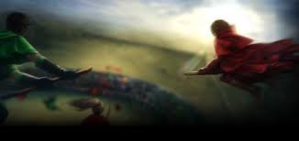
Quidditch

Slide 2
Learning Objectives
By the end of the lesson you will…
Be able to select and retrieve information from the novel.
To understand and apply the ; semi-colon.

Slide 3
Semi - colon
The semi-colon ; links two statements that are connected in some way. Here are some examples.
It was raining cats and dogs; everyone got soaked to the skin.
2. It was a dark night; the Moon hid behind the clouds.
3. Hermione studied very hard; she passed her OWLS with flying colours.

Slide 4
Semi - colon
Things to note
the semi-colon separates two complete sentences;
the second sentence has a strong relation to the first sentence;
the semi-colon can be used in the place of a connective/conjunction;
do not use a capital letter after a semi-colon unless it would have one anyway; for example ‘I’ or a proper noun such as a name.

Slide 5
Semi - colon
Add semi-colons where appropriate and explain why they are there.
Harry missed the last bus we had to walk all the way home.
Dogs are pack animals cats are solitary creatures.
Ron has taken up the drums I pity his poor friends.
A smile is the shortest distance between friends smile a lot.
Girls are from Venus boys are from Mars that’s a scientific fact.
Harry wore dress robes for the dance Ron wore his kilt.
You said robbing the bank would be easy why are we in prison then?
I beg your pardon I didn’t promise you a rose garden.
Hermione stayed out in the sun too long she looks like a greasy chip.
I thought semi-colons were difficult they’re actually quite easy!

Slide 6
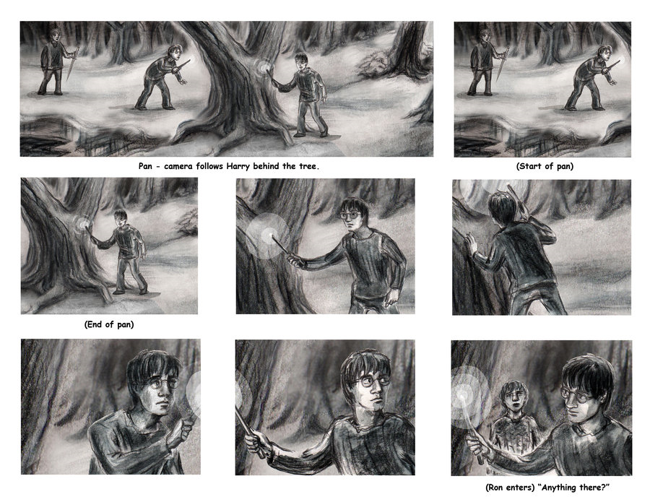
Quidditch: Storyboard
Divide a new page in your exercise book into six equal squares.
Decide on the six key events in the chapter.
Write a quotation from the novel at the bottom of each box.
Draw an image to accompany the quotation.
Check your punctuation is present and correct, especially full stops, capital letters and commas.

