Slide 1
The Vanishing Glass

Slide 2
Learning Objectives
By the end of the lesson you will…
Be able to select and retrieve information from the novel
Be able to produce a letter that uses the appropriate structure and language

Slide 3
Gorgeous Grammar

Slide 4
Relative Clause
Find the relative pronoun then look for the clause – remember the clause follows the pronoun and has a verb in it.
Example:
Broomsticks, that were bought from the shop, were magical and actually flew.
The relative clause is underlined. Were and bought are the verbs in the clause.

Slide 5
Definitions – What do they mean?
Here are four words from chapter two. Find them in the book and read the sentence they appear in. Define each one and create two of your own sentences to show your understanding of each word.
1. rapped – appears on page 20
2. frantically – appears on page 25
3. vigorously – appears on pg 29
4. hoodlum – appears on pg 27

Slide 6
Questions
Reflect on chapter 2. Answer the following questions in your book in full sentences:
What does Harry dream about before he is woken up? (page 19)
What does Harry like about his appearance and why? (page 20)
List the presents Dudley has opened. (page 21)
Why does Dudley cry? Is he really upset? Explain your answer (pg 22)
What is the magical event mentioned including school? (page 23)
What type of ice cream does Harry receive? Why? (page 24)
How does the snake behave towards Harry? (page 25)
What does the snake say to Harry when it escapes? (page 26)
Extension Task (choose one):
Imagine and describe an event from Harry’s early life where magic happens by accident and it causes chaos for those around him.
Describe the magical snake’s journey back to Brazil.

Slide 7
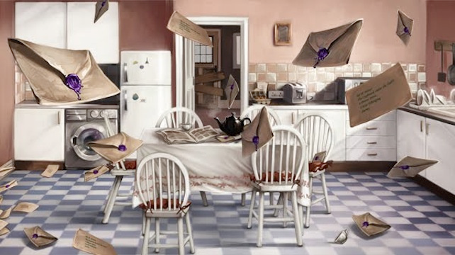
The Letters from No One

Slide 8
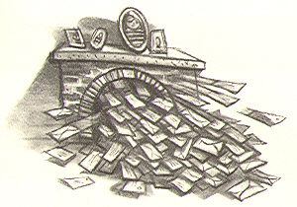
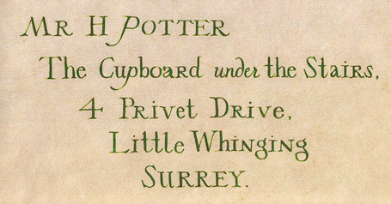
Read Chapter 3 – The Vanishing Glass
Harry receives an avalanche of letters from Hogwarts but he isn’t allowed to open even one!
Imagine what the letter could contain and write it up. Publish your letter however you choose. Use the address opposite.
Remember to make your letter sound mysterious and magical. Use a relative clause in your letter and make sure you choose powerful language and punctuate every sentence accurately using CL . , ! ‘ ; :

