Slide 1
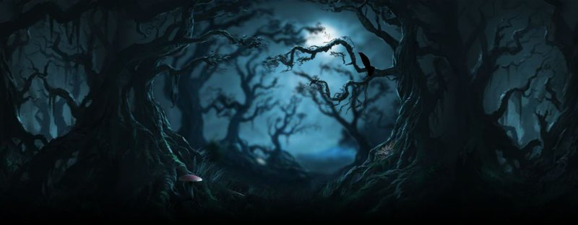
The Forbidden Forest

Slide 2
Learning Objectives
By the end of the lesson you will…
Understand how to analyse language to explore how the writer creates atmosphere.
Be able to write up your analysis in a well structured response.

Slide 3
Speech Marks Revision
Direct Speech
We use Direct Speech when we are reporting exactly what someone said.
Here are examples.
1 “You're just a little pest,” grumbled my father.
2 “Would you like more tea?” asked Granny Smith.
3. “Off with her head!” shouted the Red Queen.
4. The guest complained, “I asked for a boiled egg not a fried egg.”
5. Ashley smiled, “I really do understand this now.”
You can see how we use a comma to separate the two parts of the sentence.
A question mark or an exclamation mark can do the same job, but not a full stop because a full stop would end the sentence.

Slide 4
Speech Marks - Task
Put in the speech marks and any commas, exclamation marks or question marks that are needed in these sentences.
1 Don't do that he shouted.
2 Why not? I asked him.
3 Because I don't like it he replied.
4 Tough luck I laughed.
5 That's not an answer he screamed
6 I told him Don't shout like that.
7 He asked Why not?
8 I replied Because I don't like it.
9 He laughed Tough luck then.
10. We both laughed and said Enough. Let's go home.

Slide 5
Creating Atmosphere
Into the Forbidden Forest
The Forest was black and silent. A little way into it they reached a fork in the earth path
and Harry, Hermione and Hagrid took the left path while Malfoy, Neville and Fang took
the right.
They walked in silence, their eyes on the ground. Every now and then a ray of moonlight
through the branches above lit a spot of silver blue blood on the fallen leaves.
Harry saw that Hagrid looked very worried.
“Could a werewolf be killing the unicorns?” Harry asked.
“Not fast enough,” said Hagrid. “It’s not easy ter catch a unicorn, they’re powerful magic
creatures. I never knew one ter be hurt before.”
They walked past a mossy tree-stump. Harry could hear running water’ there must be a
stream somewhere close by. There were still spots of unicorn blood here and there along the
winding path.
“You all right, Hermione?” Hagrid whispered. “Don’t worry, it can’t’ve gone far if it’s this badly
hurt an’ then we’ll be able ter – GET BEHIND THAT TREE!”

Slide 6
Creating Atmosphere
Into the Forbidden Forest- part 2
Hagrid seized Harry and Hermione and hoisted them off the path behind a towering oak. He pulled out an arrow and fitted it into his crossbow, raising it, ready to fire. The three of them listened. Something was slithering over dead leaves nearby: it sounded like a cloak trailing along the ground. Hagrid was squinting up the dark path, but after a few seconds, the sound faded away.
“I knew it ,” he murmured. “There’s summat in here that shouldn’ be.”
“A werewolf?” Harry suggested.
“That wan’ no werewolf an’ it wan’ no unicorn, neither,” said Hagrid grimly. “Right, follow me, but careful, now.”
They walked more slowly, ears straining for the faintest sound. Suddenly, in a clearing ahead, something definitely moved.

Slide 7
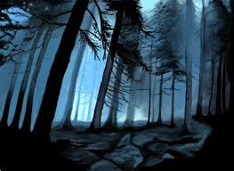
Atmosphere Study
Annotate the extracts on the powerpoint and answer the following questions using evidence to explain your answer.
How does J. K. Rowling create atmosphere in ‘The Forbidden Forest’?

Slide 8
How Does the Writer…
suggest that the forest is mysterious?
imply that Hagrid was anxious?
highlight that the unicorn was injured?
convey that Hagrid moved the children roughly?
indicate that something strange is moving through the forest?
give us the impression that something unusual is about to happen?
emphasise that the group are unsure and uncertain?
evoke feelings of fear in the reader?

