Slide 2
LO:
Use a capital letter for names of people, places, the days of the week, the months of the year and the personal pronoun ‘I’
I know that proper nouns need capital letters.
I know that the personal pronoun I is always a capital.

Slide 3
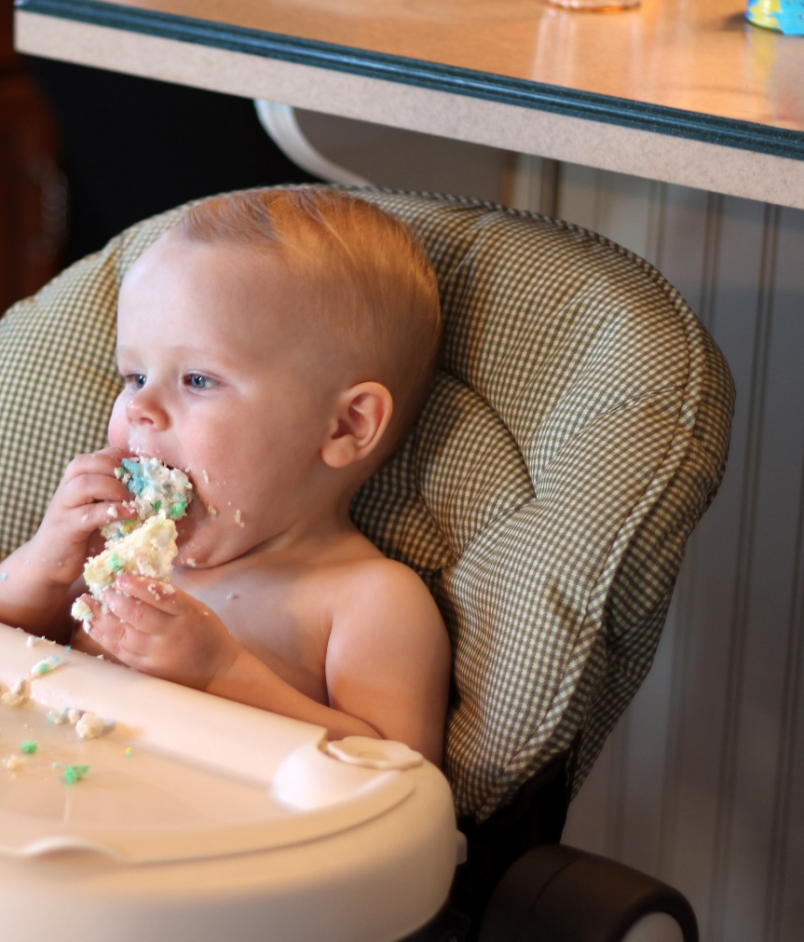
Starting Sentences
Capital letters are always used to start sentences
He loves to eat cake!
Photo courtesy of viviannguyen(@flickr.com) - granted under creative commons licence – attribution

Slide 4
Proper Nouns
Nouns are naming words.
Proper nouns are naming words for individual people, places, days of the week and months of the year.
Proper nouns all need capital letters.
Common Nouns | Proper Nouns
girl | Helen
country | England
city | Sheffield
football team | Nottingham Forest
day/month | Monday/September

Slide 5
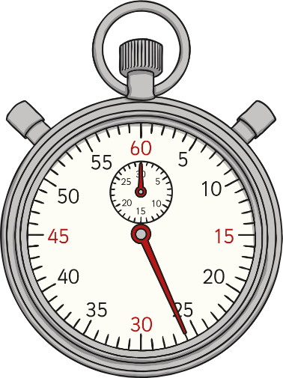
The Personal Pronoun ‘I’
When we are writing about ourselves we use the
personal pronoun ‘I’
I can tell the time.
The personal pronoun ‘I’ always needs a capital letter.

