Slide 1
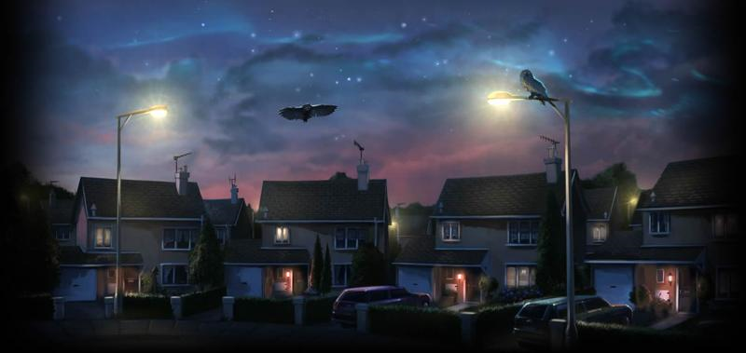
The Boy Who Lived

Slide 2
Learning Objectives
By the end of the week you will…
Be able to explore the differences and emotions between the ordinary world and the magical world
Be able to create your own wizard and write about them.

Slide 3
Gorgeous grammar
Use your word class resource from your pack to work out the class of each word in the sentences. (Do one sentence a day) Make sure you use the word class resource and work out the word classes – do not use a dictionary.

Slide 4
Were you correct?

Slide 5
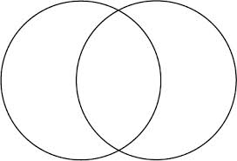
Venn Diagram
Read chapters 1 and 2 -The novel’s opening chapters introduce us to the two worlds: the ‘ordinary’ muggle world and the magical wizarding world.
Create a large Venn diagram to keep note of all of the differences and similarities between the two. Focus on characters, images and any language used to describe each. Hint: So basically what is magical and what isn’t? Extend by including people’s feelings and emotional reactions.

Slide 6
Comparison Venn Diagram
Chapters 1 & 2
Wizarding World
Muggle World
Things that are the same in both

Slide 7
Definitions – What do they mean?
Here are four words from the first chapter. Find them in the book and read the sentence they appear in.
Define each one and put it into your own sentence to show your understanding.
1. craning – found on pg 1
2. contrary – found on pg 5
3. rummaging – found on pg 9
4. exasperated – found on pg 12

Slide 8
PEE
Read the description of Albus Dumbledore on the following slide (pg 9 in the book)
P – What is your point?
E – What is your evidence?(Quotes from text)
E – Make links to what you have read so far e.g. Ordinary people in the Muggle world would not normally wear purple robes and high heeled buckled boots and ordinary people stared when they saw them
What in this description suggests this man is magical?
What in this description suggests this man is good?
What in this description suggests this man is worldly? (Wise and knowledgeable)

Slide 9
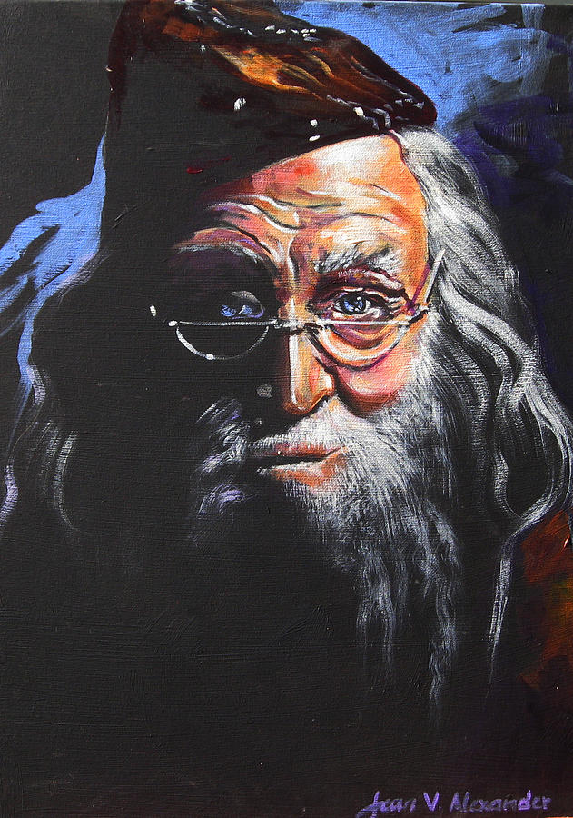
Albus Dumbledore
Nothing like this man had ever been seen in Privet Drive. He was tall, thin and very old, judging by the silver of his hair and beard, which were long enough to tuck into his belt. He was wearing long robes, a purple cloak which swept the ground and high-heeled, buckled boots. His blue eyes were light, bright and sparkling behind half-moon spectacles and his nose was very long and crooked, as though it had been broken at least twice. This man’s name was Albus Dumbledore.

Slide 10
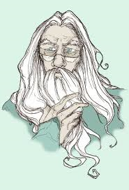
Creating your own Wizard
Write a paragraph in which you create your own wizard.
Try to explain their personality and history through your description.
Remember to punctuate each sentence carefully using CL . , ! : ;

Slide 11
Pictures from Words
Does your written description create a picture in your reader’s mind?
Use your description to draw a picture of your wizard.
Use your words to label your wizard.
Edit and review – is your description clear and powerful enough? Is there a way to improve it?
Think – could I have used:
Adjectives
Adverbs
Figurative language? Simile, metaphor, personification

