Slide 1


Identify, visualise and describe properties of 3-D shapes; Sort 3-D shapes according to their properties.
Look at the cube and cuboid. What is the same about these two shapes and what is different?
e.g.
What is different?
The cuboid has some non-square rectangular faces, it is irregular.
The cube has all squares faces, it is regular.
What is the same?
Both have the same number of faces, vertices and edges.
Both have all flat faces.
Both have 3 pairs of parallel faces.

Slide 2
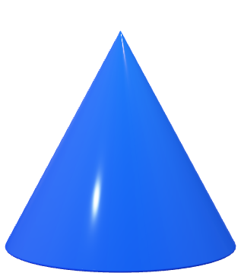
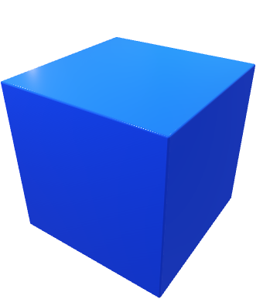
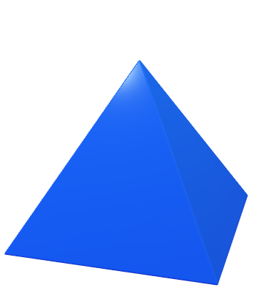
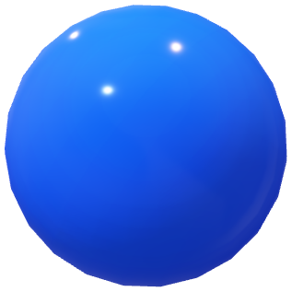
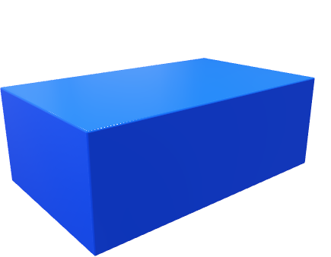
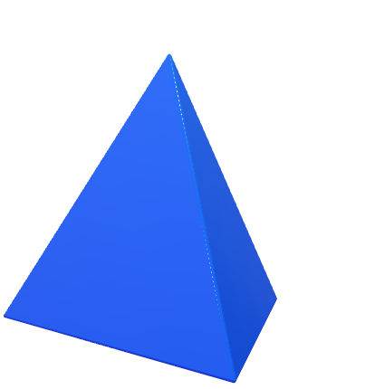
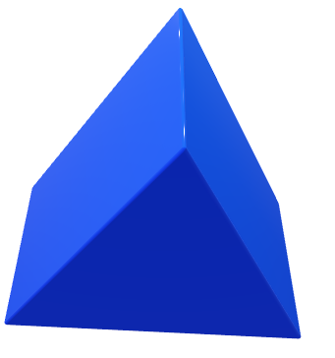
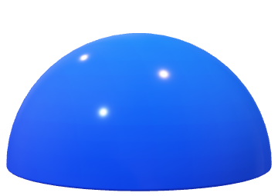
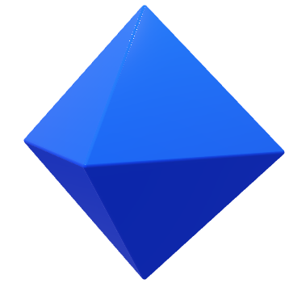
Identify, visualise and describe properties of 3-D shapes; Sort 3-D shapes according to their properties.
How many of these 3-D shapes can you name?
square-based pyramid
cuboid
triangular-
based pyramid
(tetrahedron)
cone
octahedron
hemisphere
sphere
triangular prism
cube

Slide 3
Identify, visualise and describe properties of 3-D shapes; Sort 3-D shapes according to their properties.
Carroll diagrams use two headings that are the opposite of one another (mutually exclusive), e.g.
‘has at least one triangular face’ and ‘has no triangular faces’
‘is a prism’ and ‘is not a prism’
‘is regular’ and ‘is irregular’
‘has at least one pair of parallel faces’ and ‘has no pairs of parallel faces’.
has at least one triangular face | has no triangular faces
Remember that the faces are made from 2-D shapes (two dimensions) and solids are called 3-D shapes (three dimensions).
Let’s think about sorting the shapes according to different criteria…

Slide 4
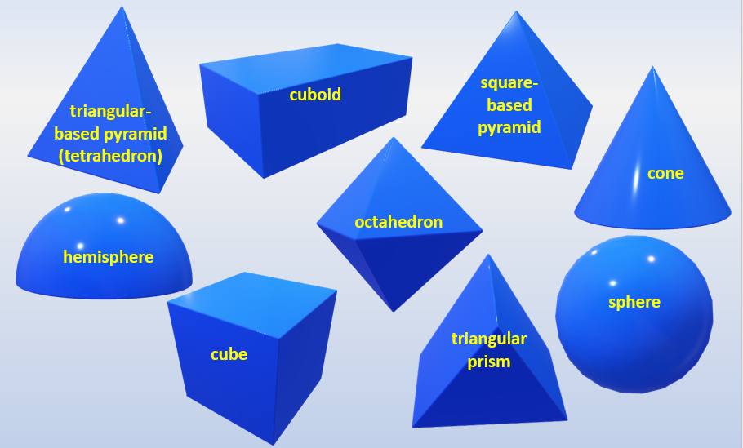
Identify, visualise and describe properties of 3-D shapes; Sort 3-D shapes according to their properties.
Where would each shape go on this Carroll diagram?
has at least one triangular face | has no triangular faces
tetrahedron
square-based pyramid
octahedron
triangular prism
cube
cuboid
cone
sphere
hemisphere

Slide 5
Identify, visualise and describe properties of 3-D shapes; Sort 3-D shapes according to their properties.
Where would each shape go on this Carroll diagram?
has at least one pair of parallel faces | has no pairs of parallel faces
cone
sphere
hemisphere
octahedron
tetrahedron
square-based pyramid
cube
cuboid
triangular prism

