Slide 1
Welcome to Class 2!
Sept 2020
Class 2
Year 1 and 2
Ms Henriques and Mrs de Bethel

Slide 2
Class 2
Promoting independence!
We aim to promote independence in KS1 please can you support your child by ensuring that they....
Bring their reading book to school every day (and you hear them at home!)
Bring a healthy snack (if they wish) and a named water bottle.
Has their name in all their clothes, bags and snack boxes.
Bring their PE kits into school on Monday, ready for PE.
Come into school by themselves.
Hand in their homework/spellings!
Independence
Please ensure that your child knows what they would like for lunch before they come into the classroom.
The school menu will be emailed to you at the beginning of each term.

Slide 3
Year 1 Phonics Screening and Year 2 SATs
May 2021
Things we will cover:-
Year 1 phonics screening
What do the SATs tests look like?
How do teachers assess/results?
Age related expectations
What can you do to help?
As far as we know Phonics Screening and SATs will take place in the Summer term
applefortheteacher.co.uk

Slide 4
The KS1 Curriculum
Our books for literacy will be the driving force for the curriculum. During the Autumn 2020 term we will be working with 2 classic novels:
Rapunzel
Alice in Wonderland
In maths our approach is based on:
Concrete or practical/hands on work
Pictorial representation of concepts
Abstract or writing things down using symbols…
applefortheteacher.co.uk

Slide 5
Age Related Expectations
At the end of the year, you will receive your child's report. They will receive information regarding there ARE (Age Related Expectations)
Working below the expected standard (not working within the Year 1/2 Curriculum).
Working towards the expected standard (some of the learning is within the Year 1/2 Curriculum).
Working at the expected standard (All learning is within the Year 1/2 Curriculum).
Working at greater depth (very secure in Year 1/2 Curriculum, with elements of Year 2/3).
applefortheteacher.co.uk

Slide 6
What is the Phonics Screen Scheck?
The Phonics Screening Check:
is meant to show how well your child can use the phonics skills they’ve learned up to the end of Year 1
to identify students who need extra phonics help
Will have simple word structures of three or four letters, and one with more complex word structures of five or six letters.
The Department for Education defines the checks as “short, light-touch assessments” that take about four to nine minutes to complete.
applefortheteacher.co.uk

Slide 7
Phonics Screening
The checks consist of 40 words and non-words that your child will be asked to read one-on-one with a teacher.
Some of the words are real words common in everyday usage.
Non-words (or nonsense words, or pseudo words) are a collection of letters that will follow phonics rules your child has been taught. Your child will need to read these with the correct sounds to show that they understand the phonics rules behind them.
Year 1’s
applefortheteacher.co.uk

Slide 8
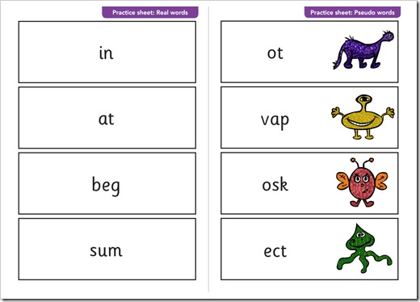
Phonics Screening
applefortheteacher.co.uk

Slide 9
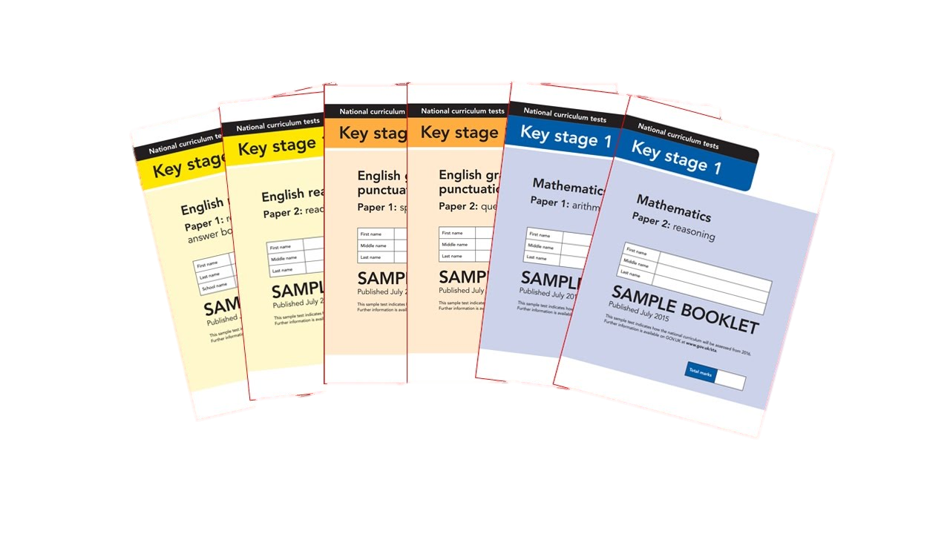
What are Sats?
At the end of Year 2, children in England sit national tests in the following subjects, the results are used to measure the school’s performance:-
*English – Reading
*Maths – Arithmetic & Reasoning
These tests reflect the updated national curriculum and are marked using the current grading system, which now replaces levels.
applefortheteacher.co.uk

Slide 10
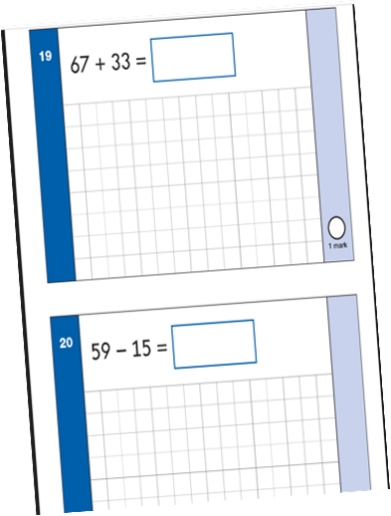
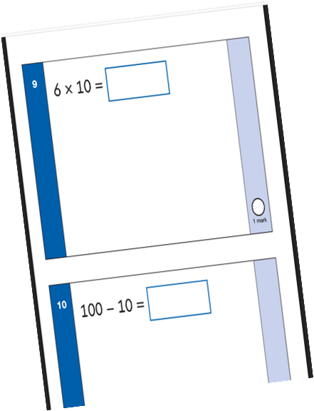
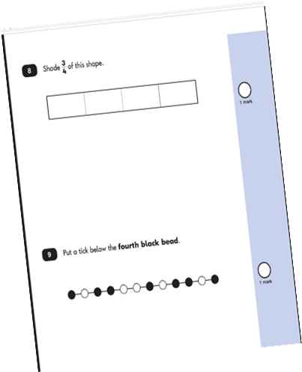
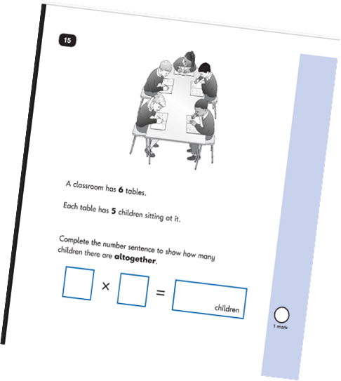
Maths SATs papers. Paper 1 will be based on Arithmetic and Paper 2 is based on Reasoning. All of the questions are based upon work done in the Year 2 curriculum that we cover in class.
applefortheteacher.co.uk

Slide 11
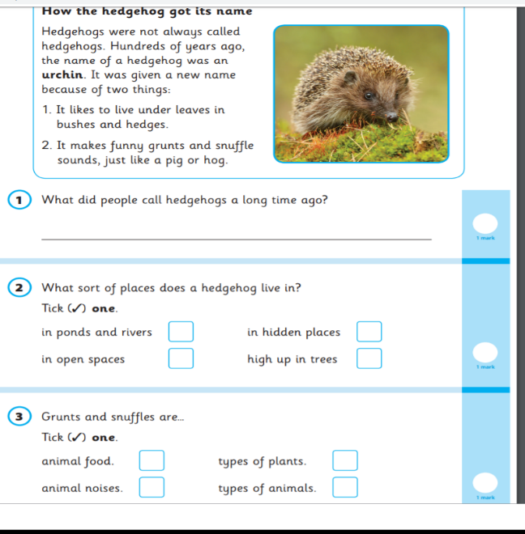
English – Reading Paper 1 Example Page
applefortheteacher.co.uk

Slide 12
Teacher Assessment/results
KS1 SATs tests are one part of evidence towards the whole teacher assessment.
They are marked in school, and an overall grading based on the whole year’s work
will be made.
The results of the SATs tests are
reported to the Local Authority.
Moderation often takes place to ensure consistency across schools.
applefortheteacher.co.uk

Slide 13
How can you help your child prepare?
Help your child with reading, listen to them read and focus on bringing out a ‘love of reading’. Also reading stories to your child allows them to develop language, listening skills and comprehension. Encourage making predictions of what might happen next.
Help your child with writing, support with weekly spellings. Write together to make shopping lists and letter writing.
Help your child with maths, play times table games. Encourage them to help with cooking, weighing and measuring ingredients. Work out what time it is together. Provide opportunities for your child to pay for things in a shop, to work out how much things cost and how much change will be needed.
applefortheteacher.co.uk

Slide 14
Class 2
Things to remember
Reading at home.
Homework
PE kits
Comes into school by themselves
Independence
We look forward to seeing you in September!

